Slide 1

Mathematical modeling of thermochemical energy storage by salt hydrates
STUDENT NAME :
DHANUSH T
KANCHAN GANDIGUDE
ROLL NO :
102120026
102120038
GUIDE NAME :
DR.JYOTI SAHU
ASST.PROFESSOR
DEPARTMENT OF CHEMICAL ENGINEERING
NATIONAL INSTITUTE OF TECHNOLOGY
TIRUCHIRAPALLI - 620015

Slide 2
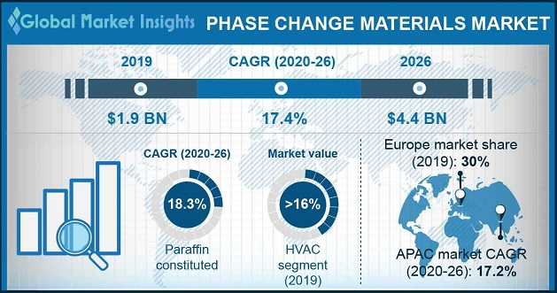
1.INTRODUCTION
LOW TEMP (-20 TO -5 C )
vaccine cold chain logistic , cold storage ,
MEDIUM TEMP (40-80 C)
domestic hot water generation ,
HIGH TEMP (80-200 C)
concentrated solar power plants ,
Phase change materials applications
MEDIUM LOW TEMP (5 TO 40 C)
heating and cooling in building ,
Fig 1 .
Fig 2 .
Phase Change Material
Organic
Paraffin Compounds
Non-Paraffin Compounds
Inorganic
Salt Hydrate
Metallic
Eutectic
Organic – Organic
Inorganic – Inorganic
Inorganic – Organic
Fig 3 .

Slide 3
2.LITERATURE REVIEW
Our literature review includes works of various researchers like
M. Gaeini (2018), who studied thermochemical heat storage in salt hydrates.
Luca Scapino (2017) studied that sorption heat storage has the potential to store large amounts of thermal energy from renewables and other distributed energy sources.
Dongdong Li (2018) studied the development of a multi-temperature thermodynamically consistent model for Salt Lake brine systems.
Christoph Rathgeber (2019) worked on the modified BET equations that are extended to calculate solubility phase diagrams of concentrated salt solutions with relatively high-water activities within the range of under saturation.
And many more to add on.

Slide 4
2.LITERATURE REVIEW
Debye-Huckel equation
Davis Equation
Pitzer Equation
BET Model
Pitzer Simonson Clegg
Various Thermodynamic models

Slide 5
3.RESEARCH GAP AND NOVELTY
1
Lack of experimental data at high temperature and pressure and validation
2
Model accounting for salt hydrates at elevated temperature, pressure, and concentration
3
Accounting of unstable chemical reactions.
Accounting of complex phase equilibria ( liquid: solid).
4

Slide 6
4.OBJECTIVEs
Study of phase change materials
Development of a thermodynamical model for various salt hydrates
Validation of results with experimental data.

Slide 7
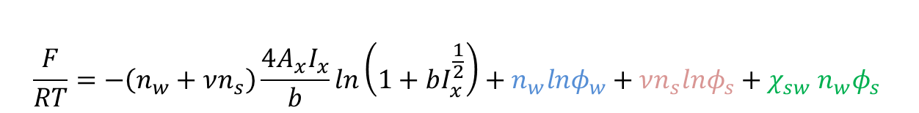
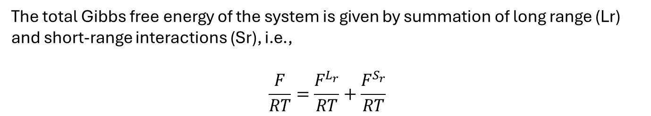
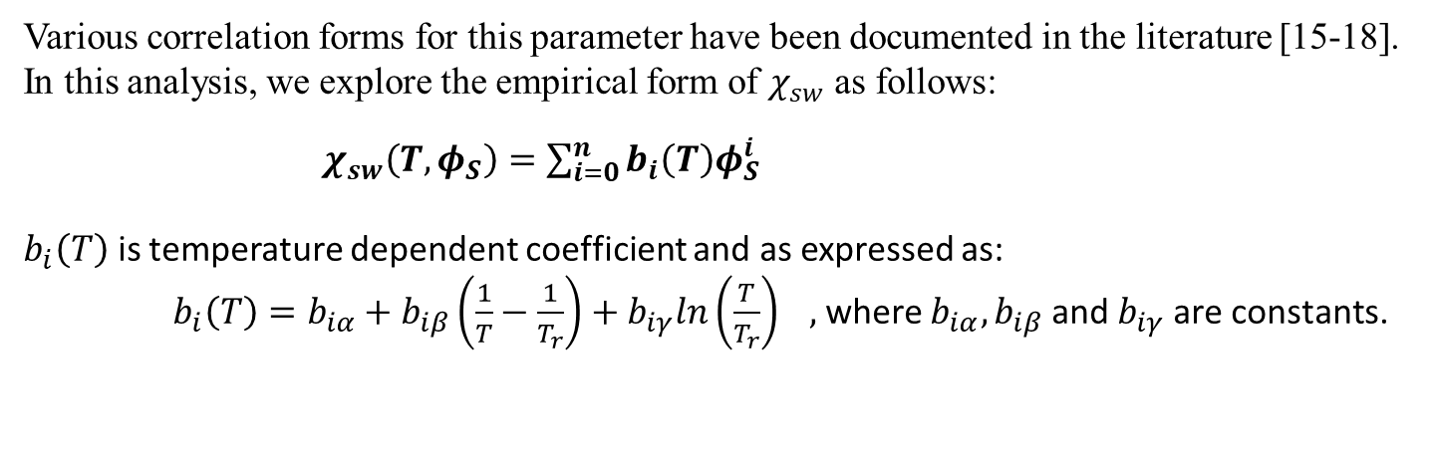
5.METHODOLOGY
The total Gibbs free energy of the system is given by summation of long range (Lr) and short-range interactions (Sr), i.e.,
$$\frac{F}{RT}=\frac{F^{L_{r}}}{RT}+\frac{F^{S_{r}}}{RT}$$
: Water-Water Interaction
: Salt-Salt Interaction
: Salt-Water Interaction
$$\frac{F}{RT}=−\left(n_{w}+νn_{s}\right)\frac{4A_{x}I_{x}}{b}ln\left(1+bI_{x}^{\frac{1}{2}}\right)+n_{w}lnφ_{w}+νn_{s}lnφ_{s}+χ_{sw} n_{w}φ_{s}$$
Long Range
( Debye-Huckel’s Equation )
Short Range
( Flory-Huggins Equation )
Various correlation forms for this parameter have been documented in the literature [15-18]. In this analysis, we explore the empirical form of $χ_{sw}$ as follows:
$χ_{sw}\left(T,φ_{S}\right)=\sum_{i=0}^{n}{b_{i}\left(T\right)φ_{S}^{i}}$
$b_{i}\left(T\right)$ is temperature dependent coefficient and as expressed as:
$b_{i}\left(T\right)=b_{iα}+b_{iβ}\left(\frac{1}{T}−\frac{1}{T_{r}}\right)+b_{iγ}ln\left(\frac{T}{T_{r}}\right) ,$where $b_{iα}, b_{iβ}$and $b_{iγ}$ are constants.

Slide 8
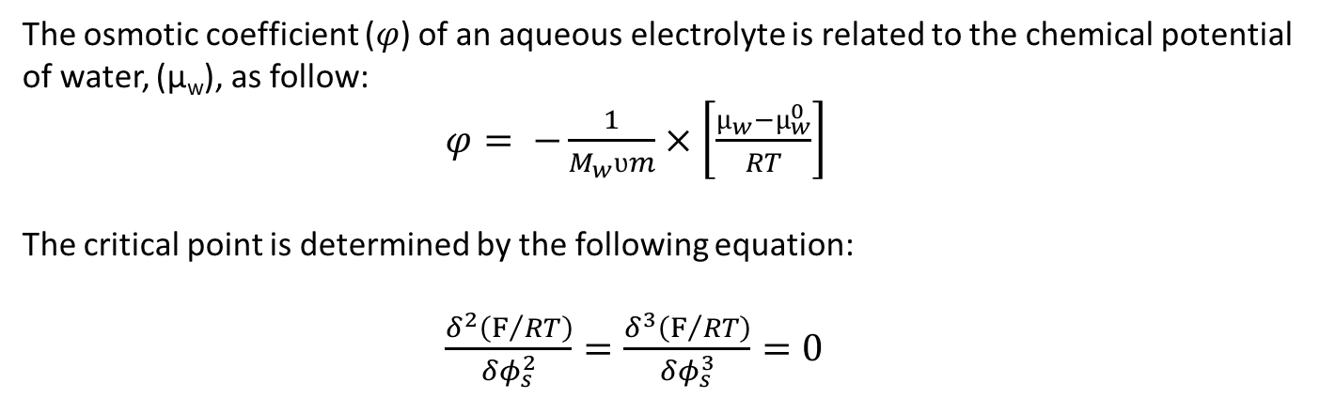
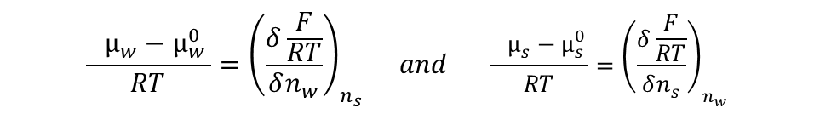
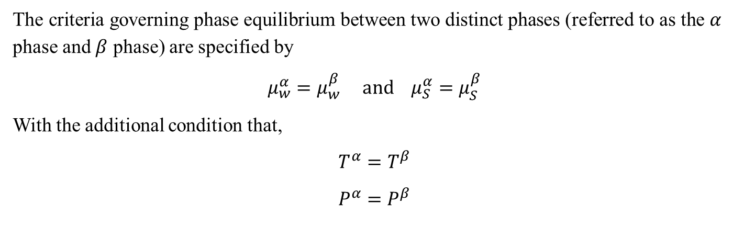
Derivative of total Gibbs free energy equation w. r. t. moles of water and salt gives us chemical potential of water and salt hydrates, respectively.
$$\frac{{ µ_{w}−µ}_{w }^{0}}{RT}={\left(\frac{δ\frac{F}{RT}}{δn_{w}}\right)}_{n_{s}} and \frac{{ µ_{s}−µ}_{s }^{0}}{RT}={\left(\frac{δ\frac{F}{RT}}{δn_{s}}\right)}_{n_{w}}$$
The criteria governing phase equilibrium between two distinct phases (referred to as the $α$ phase and $β$ phase) are specified by
$$μ_{w}^{α}=μ_{w}^{β} and μ_{S}^{α}=μ_{S}^{β}$$
With the additional condition that,
$$T^{α}=T^{β}$$
$$P^{α}=P^{β}$$
The osmotic coefficient ($φ$) of an aqueous electrolyte is related to the chemical potential of water, (µ_{w}), as follow:
$φ= −\frac{1}{M_{w}ʋm}×\left[\frac{µ_{w}−µ_{w}^{0}}{RT}\right]$
The critical point is determined by the following equation:
$\frac{δ^{2}\left(F/{RT}\right)}{δφ_{s}^{2}}=\frac{δ^{3}\left(F/{RT}\right)}{δφ_{s}^{3}}=0$

Slide 9
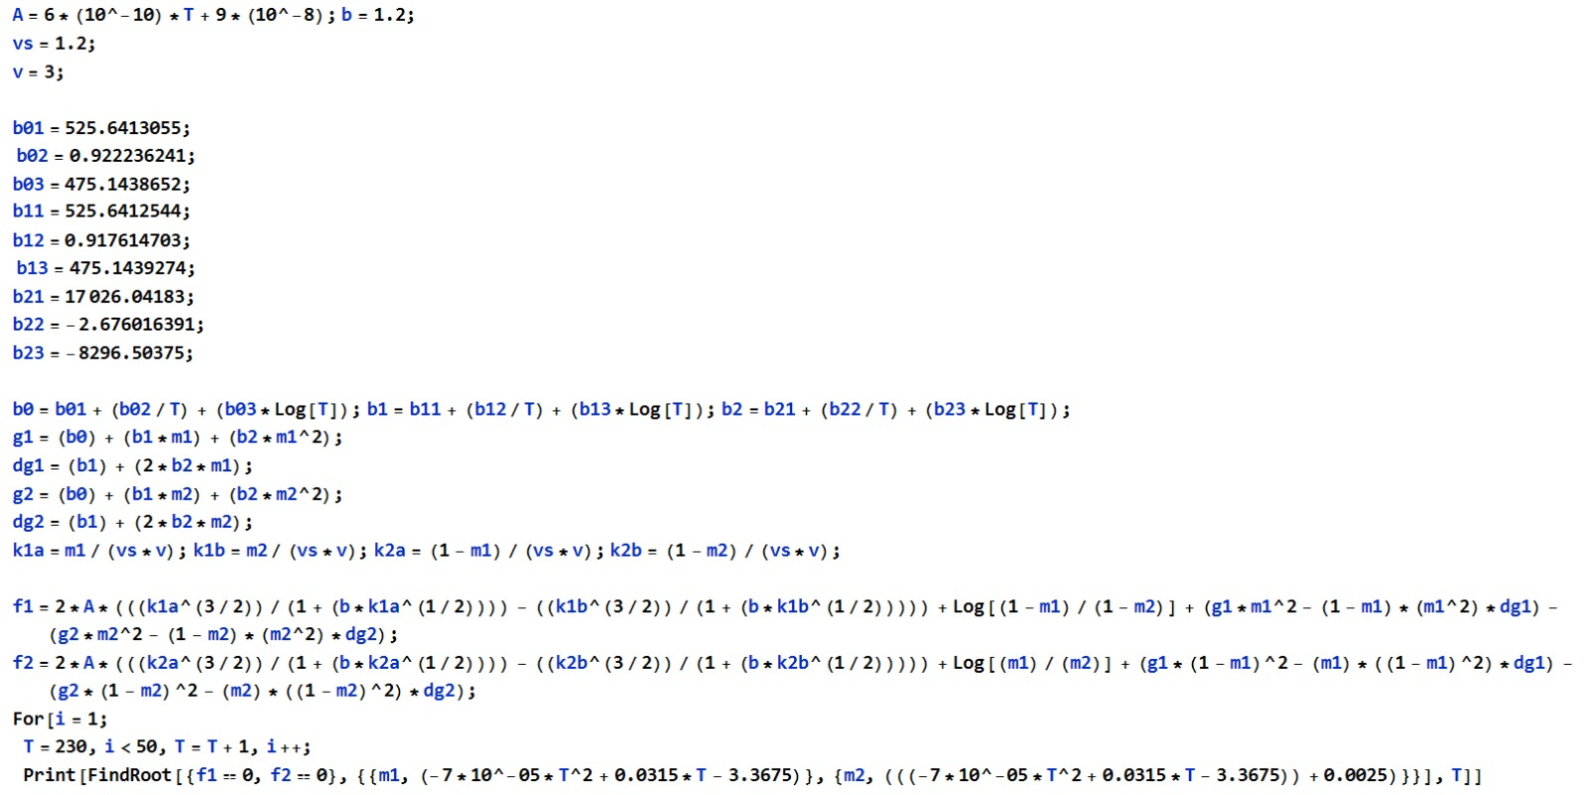
MATHEMATICA software SAMPLE CODE FOR N=2

Slide 10
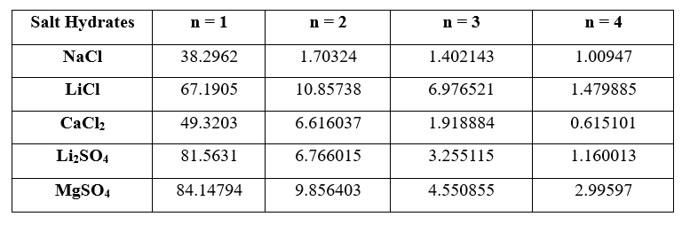
6.RESULT AND DISCUSSION
Table – 1: The comparison table for the deviation percentage for osmotic coefficient from our work with the reference values

Slide 11
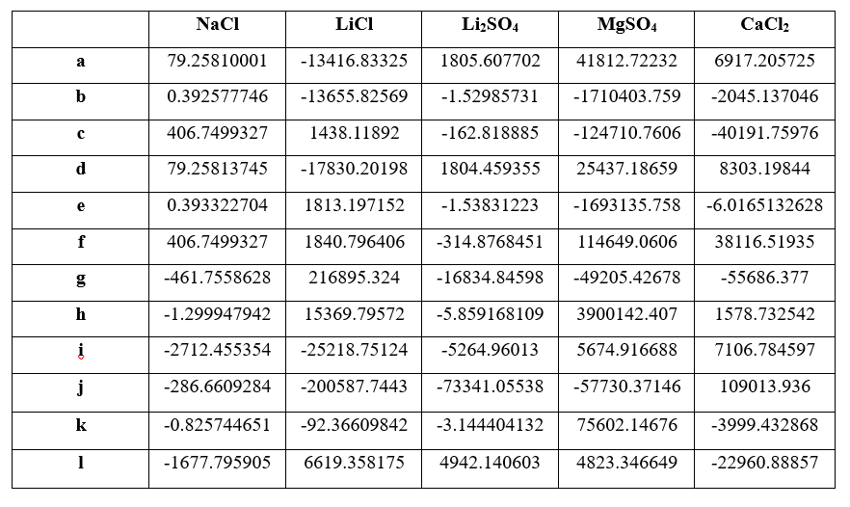
Table – 2: Regression parameters of model ($b_{iα}$, $b_{iβ}$ and $b_{iγ})$ for n=3

Slide 12
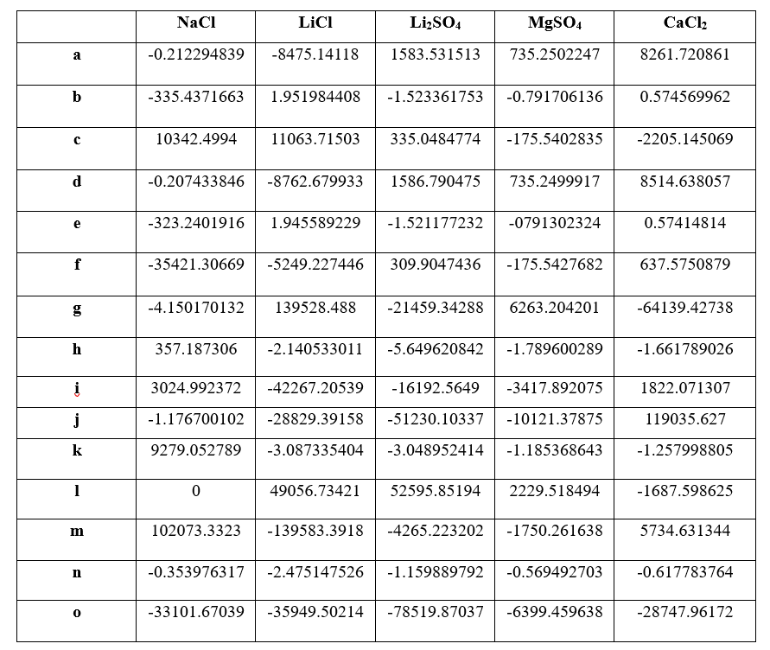
Table – 3: Regression parameters of model ($b_{iα}$, $b_{iβ}$ and $b_{iγ})$for n = 4

Slide 13
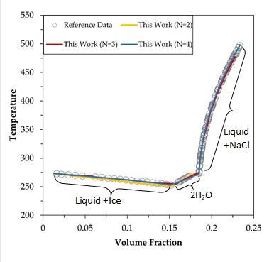
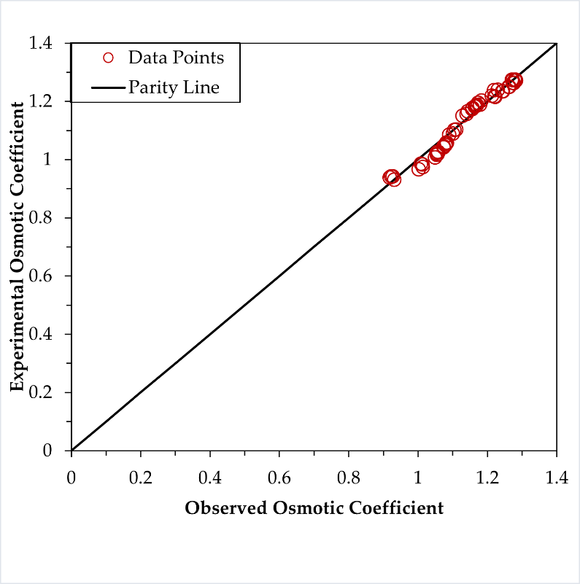
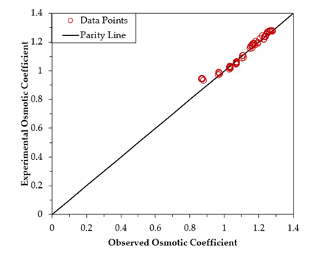
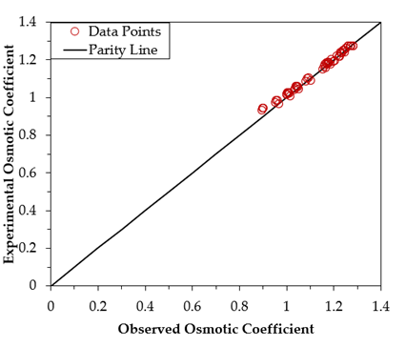
1. NaCl
Fig 1. Phase diagram of the NaCl + H₂O system : reference data [1-2].
Fig 2. Parity plot of NaCl for N=2
Fig 3. Parity plot of NaCl for N=3
Fig 4. Parity plot of NaCl for N=4

Slide 14
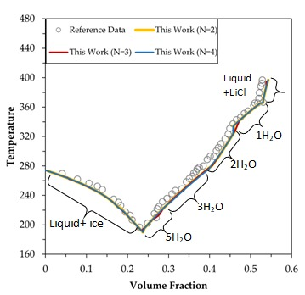
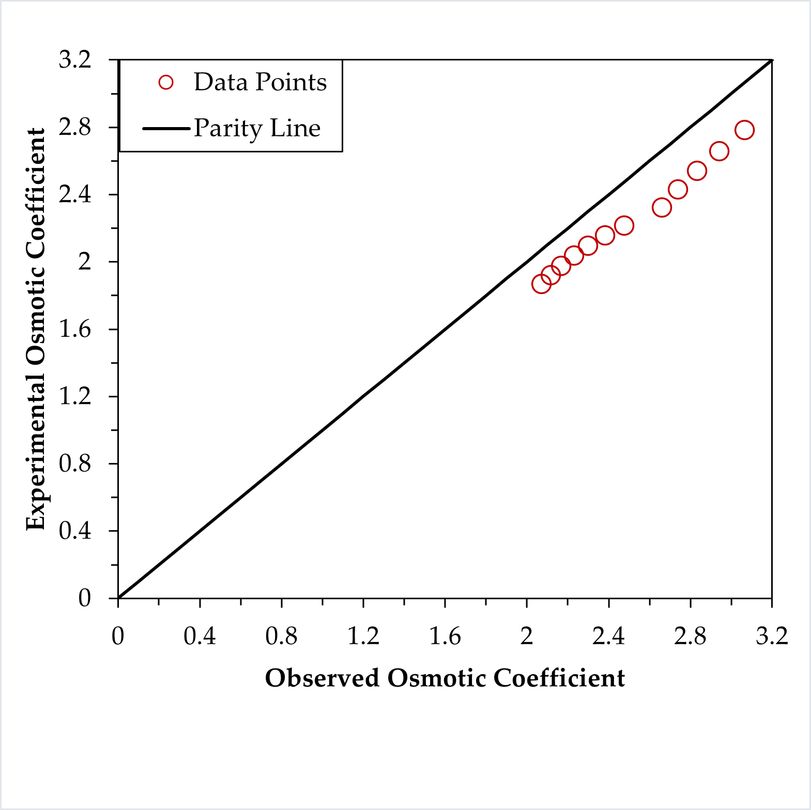
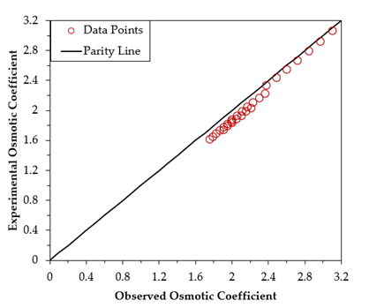
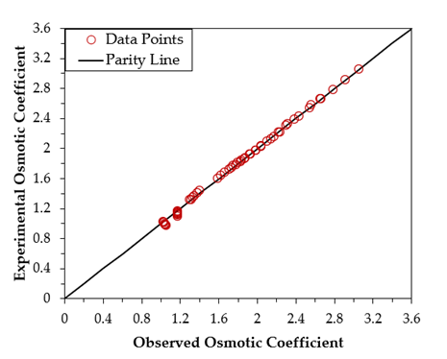
2. LiCl
Fig 5. Phase diagram of the LiCl+H₂O system reference data [1-3]
Fig 6. Parity plot of LiCl for N=2
Fig 7. Parity plot of LiCl for N=3
Fig 8. Parity plot of LiCl for N=4

Slide 15
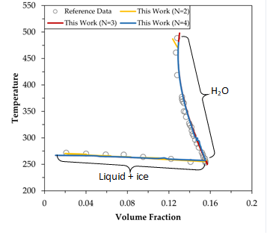
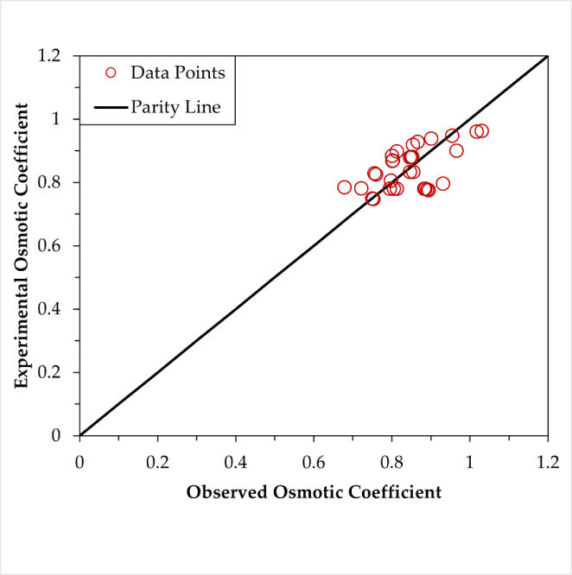
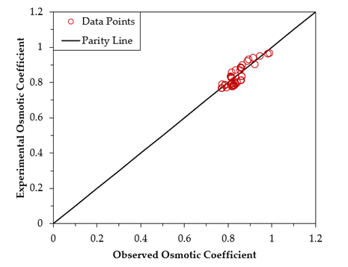
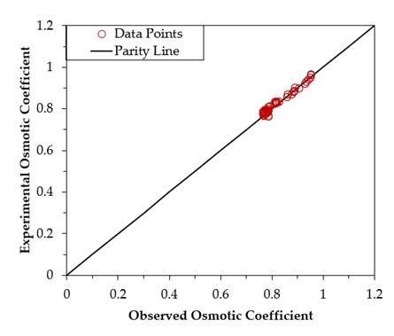
3. Li₂SO₄
Fig 9. Phase diagram of the Li₂SO₄+H₂O system reference data [1-3].
Fig 10. Parity plot of Li₂SO₄ for N=2
Fig 11. Parity plot of Li₂SO₄ for N=3
Fig 12. Parity plot of Li₂SO₄ for N=4

Slide 16
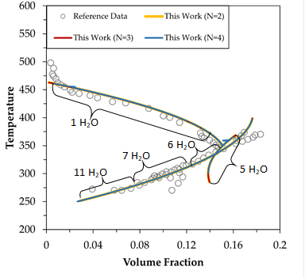
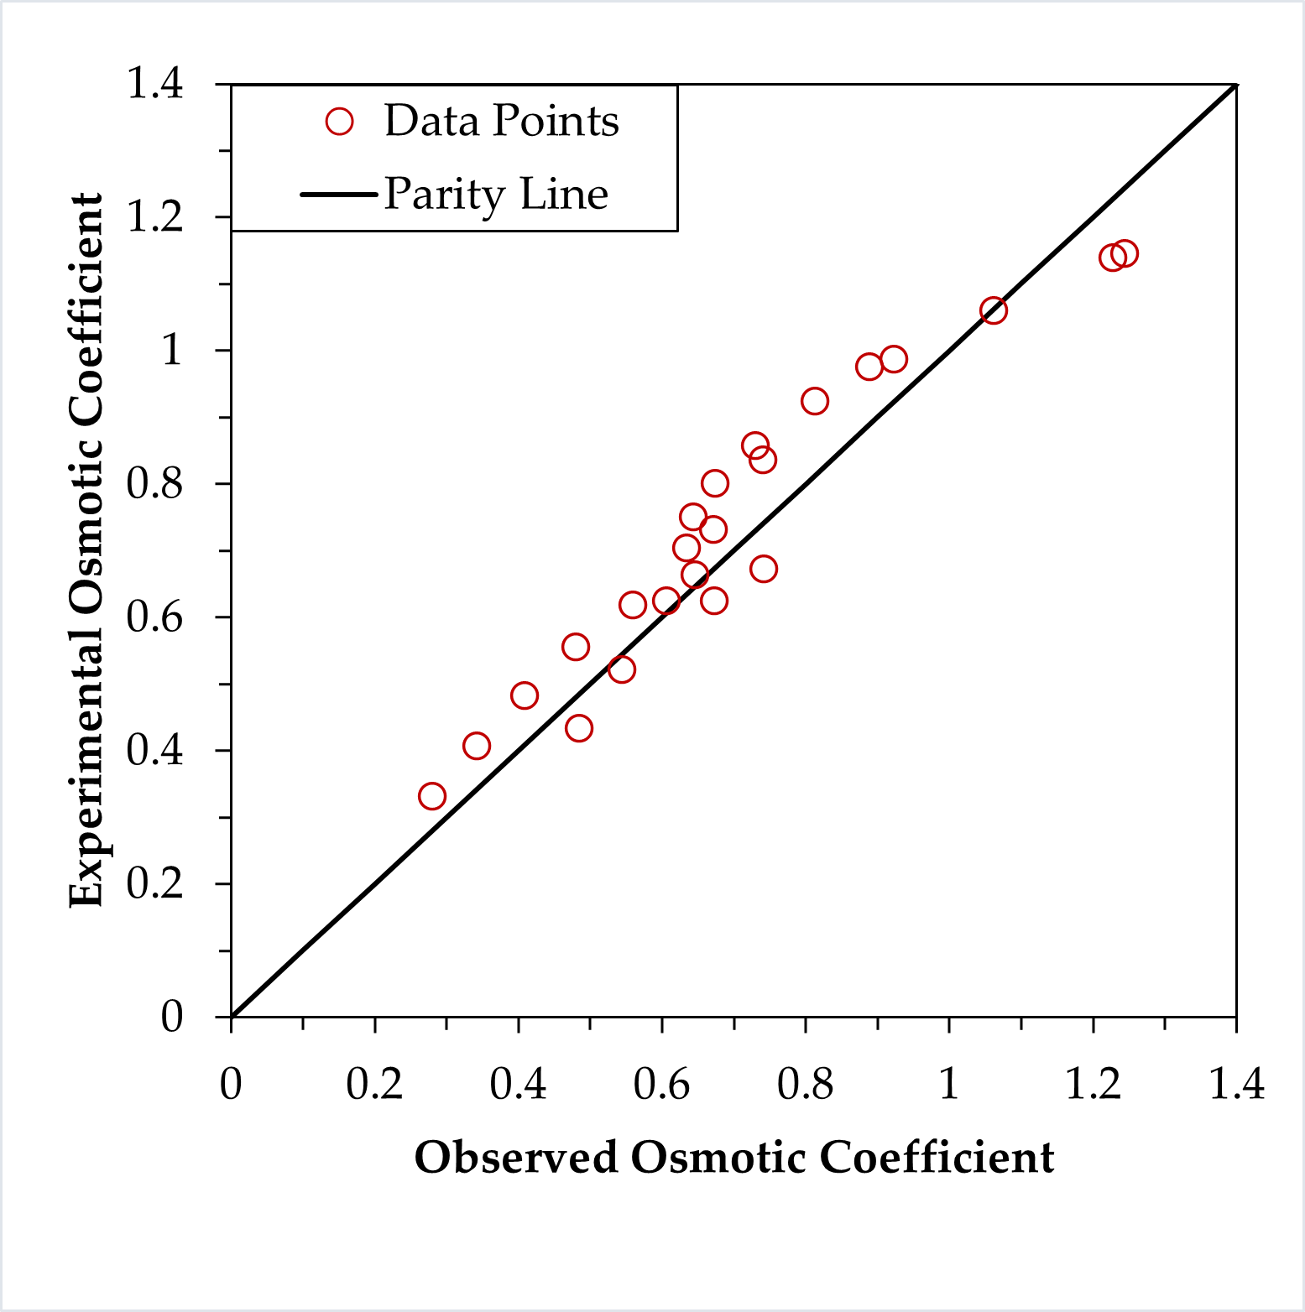
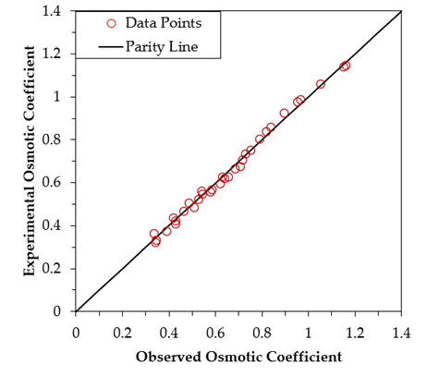
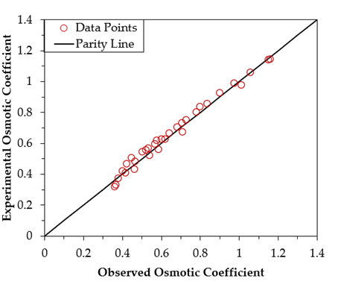
4. MgSO₄
Fig 13. Phase diagram of the MgSO₄ + H₂O system reference data [9,14-16].
Fig 14. Parity plot of MgSO₄ for N=2
Fig 15. Parity plot of MgSO₄ for N=3
Fig 16. Parity plot of MgSO₄ for N=4

Slide 17
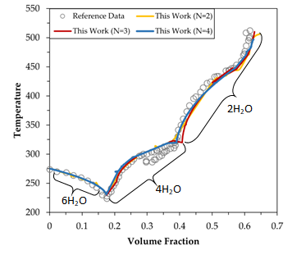
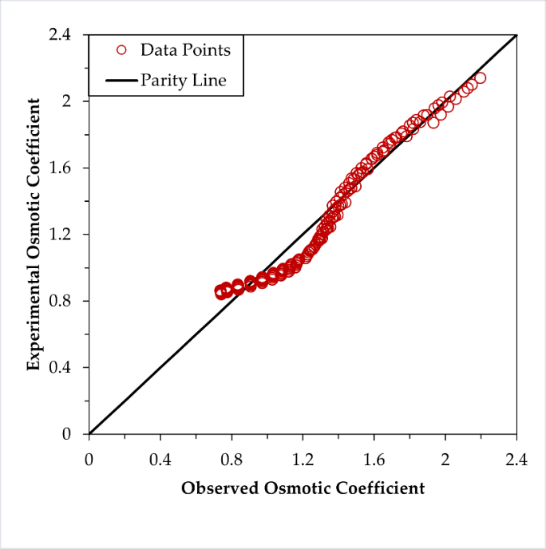
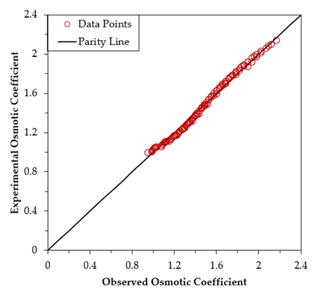
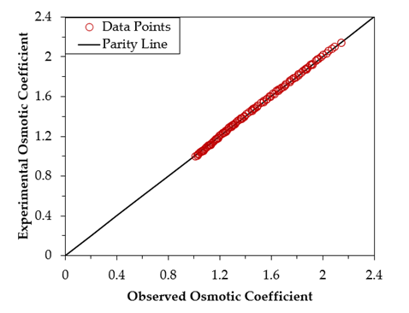
5. CaCl₂
Fig 17. Phase diagram of the CaCl₂ + H₂O system reference data [4-8].
Fig 18. Parity plot of CaCl₂ for N=2
Fig 19. Parity plot of CaCl₂ for N=3
Fig 20. Parity plot of CaCl₂ for N=4

Slide 18
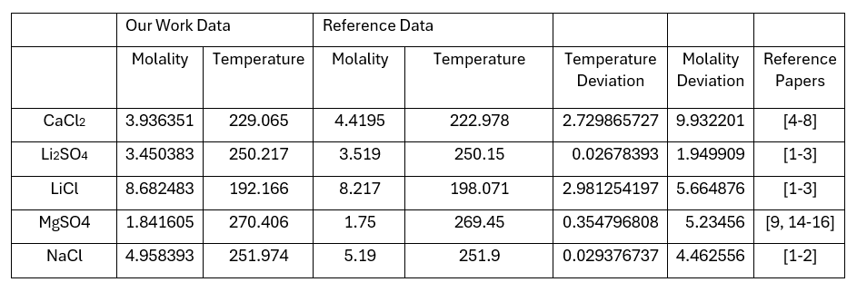
Table – 4: Critical point values that we derived, and deviations are tabulated the reference data

Slide 19
6.SUMMARY AND CONCLUSION
In summary, this work has made a substantial contribution to our knowledge of the phase equilibria and thermodynamic characteristics of five binary sulfate and chloride systems (Li2SO4+ H2O, LiCl + H2O, MgSO4 + H2O, CaCl2 + H2O, and NaCl + H2O). We have successfully simulated and analyzed a broad range of thermodynamic properties important to these systems by utilizing the PSC excess Gibbs energy model within a comprehensive thermodynamic framework.
The accuracy and dependability of our established model parameters are importantly confirmed by our comparisons with previously published experimental or model values in the literature. Our results will have a great impact on the global study and use of salt lake brine systems, and they provide a substantial contribution to the subject of thermodynamics overall.

Slide 20
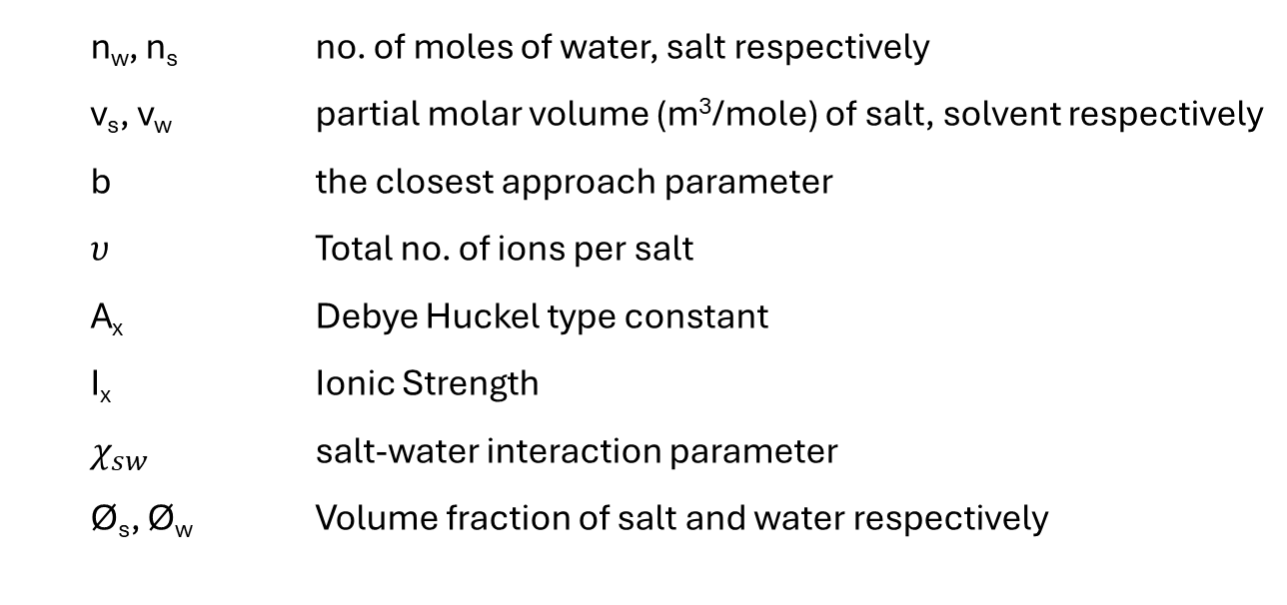
Nomenclature
n_{w}, n_{s} no. of moles of water, salt respectively
v_{s}, v_{w} partial molar volume (m³/mole) of salt, solvent respectively
b the closest approach parameter
$υ$ Total no. of ions per salt
A_{x} Debye Huckel type constant
I_{x} Ionic Strength
$χ_{sw}$ salt-water interaction parameter
Ø_{s}, Ø_{w} Volume fraction of salt and water respectively

Slide 21
REFERENCES
Pielichowska, K.; Pielichowski, K. Phase change nanomaterials for thermal energy storage. In Nanotechnology for Energy Sustainability; Wiley: Hoboken, NJ, USA, 2017; pp. 459–484.
H. Lahmidi, S. Mauran, V. Goetz, Definition, test and simulation of a thermochemi cal storage process adapted to solar thermal systems, Sol. Energy 80 (7) (2006) 883–893
Li, D., Zeng, D., Yin, X., Han, H., Guo, L., & Yao, Y. (2016). Phase diagrams and thermochemical modeling of salt lake brine systems. II. NaCl+ H2O, KCl+ H2O, MgCl2+ H2O and CaCl2+ H2O systems. Calphad, 53, 78-89.
Guendouzi, M. E., Mounir, A., & Dinane, A. (2003). Water activity, osmotic and activity coefficients of aqueous solutions of Li2SO4, Na2SO4, K2SO4,(NH4) 2SO4, MgSO4, MnSO4, NiSO4, CuSO4, and ZnSO4 at T= 298.15 K. The Journal of Chemical Thermodynamics, 35(2), 209-220.
Pillay, V., Gärtner, R. S., Himawan, C., Seckler, M. M., Lewis, A. E., & Witkamp, G. J. (2005). MgSO4+ H2O System at Eutectic Conditions and Thermodynamic Solubility Products of MgSO4 12H2O (s) and MgSO4⊙ 7H2O (s). Journal of Chemical & Engineering Data, 50(2), 551-555.
Li, D., Zeng, D., Yin, X., & Gao, D. (2018). Phase diagrams and thermochemical modeling of salt lake brine systems. III. Li2SO4+ H2O, Na2SO4+ H2O, K2SO4+ H2O, MgSO4+ H2O and CaSO4+ H2O systems. Calphad, 60, 163-176.
Archer, D. G., & Rard, J. A. (1998). Isopiestic Investigation of the Osmotic and Activity Coefficients of Aqueous MgSO4 and the Solubility of MgSO4⊙ 7H2O (cr) at 298.15 K: Thermodynamic Properties of the MgSO4+ H2O System to 440 K. Journal of Chemical & Engineering Data, 43(5), 791-806.

Slide 22
REFERENCES
Yang, H., Zeng, D., Wang, Q., Chen, Y., & Voigt, W. (2016). Isopiestic measurements of water activity for the Li2SO4–MgSO4–H2O system at 323.15 and 373.15 K. Journal of Chemical & Engineering Data, 61(9), 3157-3162.
Guendouzi, M. E., Mounir, A., & Dinane, A. (2003). Water activity, osmotic and activity coefficients of aqueous solutions of Li2SO4, Na2SO4, K2SO4,(NH4) 2SO4, MgSO4, MnSO4, NiSO4, CuSO4, and ZnSO4 at T= 298.15 K. The Journal of Chemical Thermodynamics, 35(2), 209-220.
Monnin, C., Dubois, M., Papaiconomou, N., & Simonin, J. P. (2002). Thermodynamics of the LiCl+ H2O system. Journal of Chemical & Engineering Data, 47(6), 1331-1336.
Pátek, J., & Klomfar, J. (2006). Solid–liquid phase equilibrium in the systems of LiBr–H2O and LiCl–H2O. Fluid Phase Equilibria, 250(1-2), 138-149.
Li, D., Zeng, D., Han, H., Guo, L., Yin, X., & Yao, Y. (2015). Phase diagrams and thermochemical modeling of salt lake brine systems. I. LiCl+ H2O system. Calphad, 51, 1-12.
Rard, J. A., Clegg, S. L., & Palmer, D. A. (2007). Isopiestic determination of the osmotic and activity coefficients of Li 2 SO 4 (aq) at T= 298.15 and 323.15 K, and representation with an extended ion-interaction (Pitzer) model. Journal of solution chemistry, 36, 1347-1371.
Hamer, W. J., & Wu, Y. C. (1972). Osmotic coefficients and mean activity coefficients of uni‐univalent electrolytes in water at 25° C. Journal of Physical and Chemical Reference Data, 1(4), 1047-1100.

Slide 23
REFERENCES
Maojie Chai, Min Yang, Rundong Qi, Zhangxin Chen, Jing Li, (2022) Vapor-liquid equilibrium (VLE) prediction for dimethyl ether (DME) and water system in DME injection process with Peng-Robinson equation of state and composition dependent binary interaction coefficient, Journal of Petroleum Science and Engineering, 211, 110172
Irong Nie, Ziwei Zheng, Mingxia Lu, Shun Yao, Dong Guo. (2022) Phase Behavior of Ionic Liquid-Based Aqueous Two-Phase Systems. International Journal of Molecular Sciences, 23 (20), 12706. https://doi.org/10.3390/ijms232012706
Lalaso V. Mohite, Vinay A. Juvekar, Jyoti Sahu. (2019) Quantification of Polymer–Surface Interaction Using Microcalorimetry. Industrial & Engineering Chemistry Research, 58 (18), 7495-7510. https://doi.org/10.1021/acs.iecr.8b04792
Edgar J. Acosta, Arti S. Bhakta. (2009) The HLD‐NAC Model for Mixtures of Ionic and Nonionic Surfactants. Journal of Surfactants and Detergents,12 (1), 7-19. https://doi.org/10.1007/s11743-008-1092-4

Slide 24
THANK YOU

